Slide 1
Shadow Detection and Removal
Team:
Dr. Margret Anouncia S
Dr. Mythili T
Mr. Bhavesh Goyal (18BCE2521)
Mr. Loukik Bhangale (17BCE0961)
Mr. Narayanasetty Swarag (18BCI0154)
Mr. Kamlendra Pratap Singh (18BIT0169)
School of Computer Science and Engineering
Vellore Institute of technology, Vellore-14

Slide 2
Problem Statement
Design and development of a robust, reliable procedure to detect the unwanted sharp shadows caused by the flash and to remove these shadows for obtaining shadow free objects in an image.

Slide 3
Inside
Methodology
Results
Conclusion

Slide 4
Methodology

Slide 5
List of Modules
Image Acquisition
Image Pre-Processing
Shadow Detection Model
Post-Processing
Generation of shadow free image

Slide 6
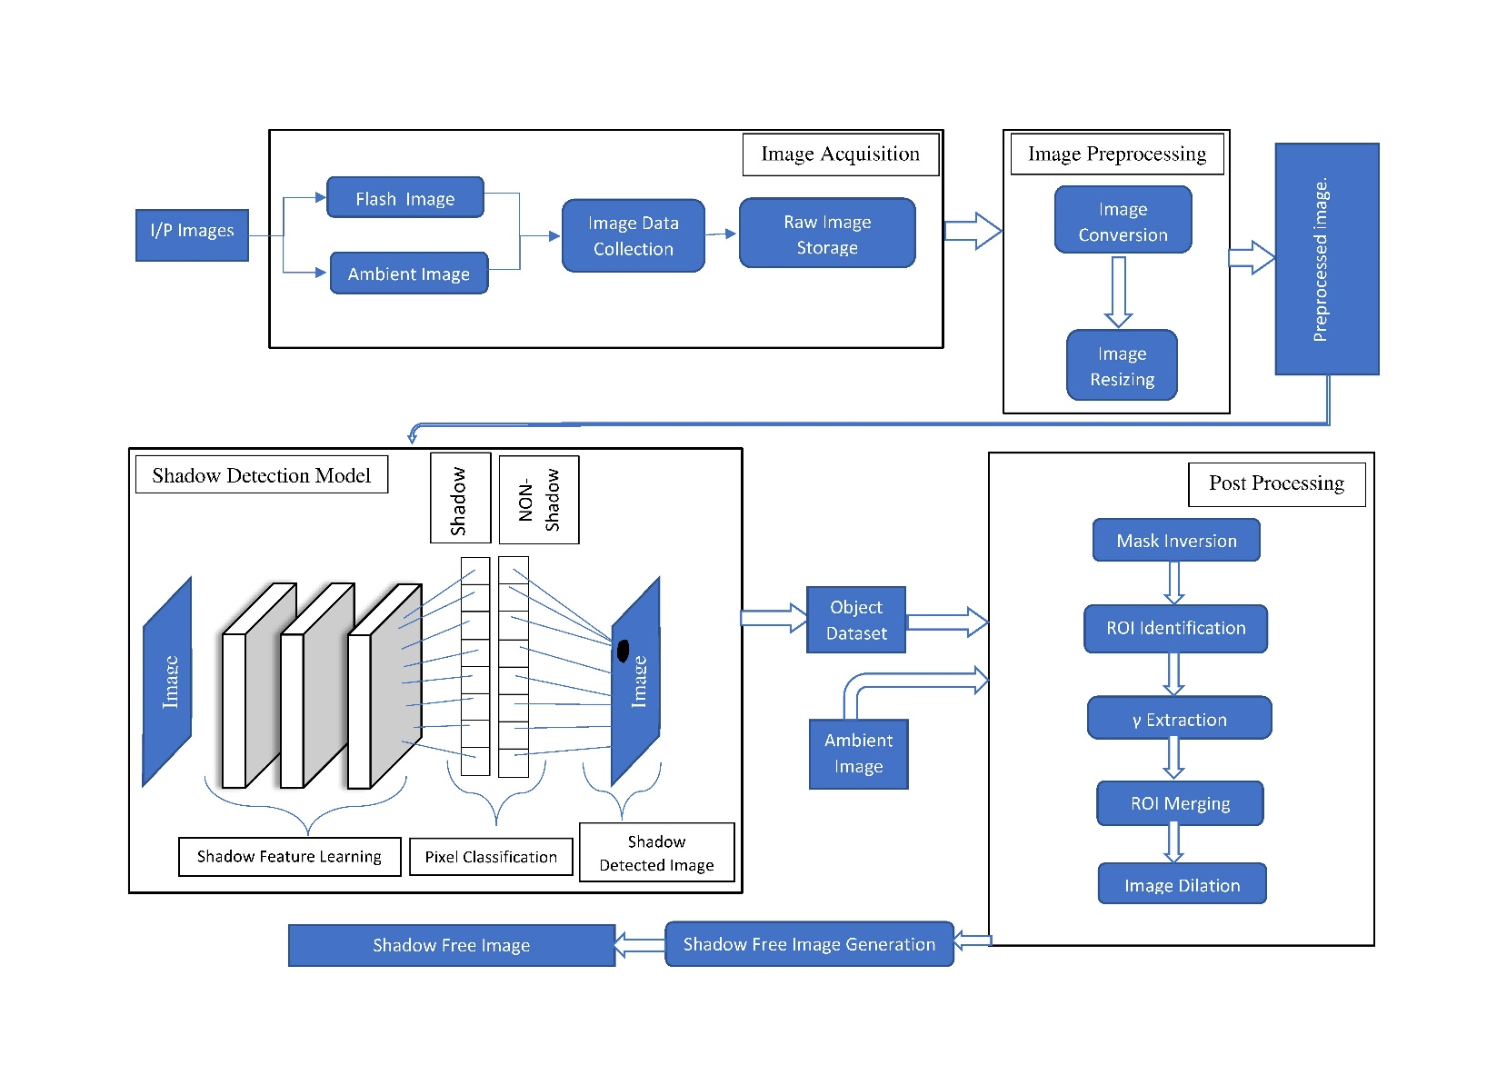
Architecture of the Shadow Detection System

Slide 7
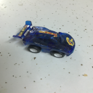
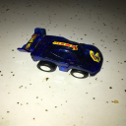



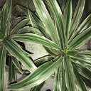
Image Acquisition
Images are read by system as Flash and NON Flash Images
Ambient | Flash

Slide 8
Image Pre-Processing

Slide 9

Image Pre-Processing
The input image is converted to RGB format from BGR and is reduced to the size of 128x128 pixels.
The image is converted into 8-bit.
This will act as an input of the shadow detection model
Input | Output

Slide 10
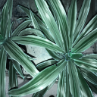
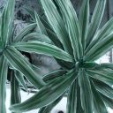
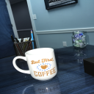
Images after Pre-Processing
Input |  | Output
Flash | Ambient | Flash | Ambient

Slide 11
Shadow Detection Model

Slide 12
Shadow Detection Model
The pre-processed image is provided as input to the Shadow Detection Model
The model is built on U-Net architecture.
It has been trained on the ISTD dataset.
The model yielded an accuracy of 92%
Both the flash and non-flash images are provides as input.

Slide 13
Architecture model of U-Net
The CNN model is based on the u-net architecture involving a total of 42 layers.
A three dimensional array of shape (128, 128, 3) of RGB format is provided as the input to the first layer of the model.
In the second layer the image is normalized by dividing itself by 255.
Multiple 2D-Convolution, Max pooling and Dropout layers have been constructed.
The 2D-Convolution have varying filters, kernel size 3 with elu activation and he normal kernel initializer. The kernel size for Max pooling is 3 which takes 9 pixels and results the maximum value. The Dropout layer is used to prevent over fitting. Dropout works by randomly setting the outgoing edges of hidden units (neurons that make up hidden layers) to 0 at each update of the training phase.

Slide 14
Architecture model of U-Net (cont.)
Further multiple 2D-Convolution Transpose, Concatenation, 2D-Convolution and Max pooling layers have been added.
The 2D-Convolution Transpose have varying filters with a kernel size of 2 and stride of 2. The Concatenation layer combines the transpose layer above it with a 2D-Convolution layer of the same number of filters defined above, thus giving it a U shape. The 2D-Convolution has the same number of filters as the transpose layer, kernel size 3 with elu activation and he normal kernel initializer. The kernel size for Max pooling is 3 which takes 9 pixels and results the maximum value.

Slide 15
Architecture model of U-Net (cont.)
The final layer is a 2D-Convolution with 1 filter and kernel size of 1. It has sigmoid activation.
The final output is mapped to the true shadow mask, from where it learns the shadow and non-shadow pixels.
The weights of the model are computed automatically with adam optimizer and binary cross-entropy loss function.

Slide 16
Procedure for shadow detection using U-Net (CNN)
//In the subsequent lines 2CN, MP, DO, CAT and 2CT stands for 2D-Convolution, Max Pooling, Dropout, Concatenation and 2D-Convolution Transpose respectively.
The word params stand for the parameters: Exponential Linear Unit (ELU) activation and He-normal kernel initializer and kernel size 3.//
Procedure Shadow_Detection(…)
Begin
Input a three dimensional array of shape (128, 128, 3) of RGB format
Apply Normalization to get Normalized Image (Img)
Begin
For e 1→ epochs:
Weights initialized and updated with adam optimizer
For i 1→4:
Img←2CN with params with 2^(3+i) filters
Img←MP
Img←2CN with params with 2^(3+i) filters
Img←DP
Endfor

Slide 17
Procedure for shadow detection using U-Net (CNN)..
Img←2CN with params with 2^(8) filters
Img←MP
Img←2CN with params with 2^(8) filters
Endfor
For i 1->4:
Begin
Img←2CT with 2^(8-i) filters
IMG←CAT with Img with 2^(8-i) filters
Img←2CN with params with 2^(8-i) filters
Img←MP
Img←2CN with params with 2^(8-i) filters
Img← 2CN with params with 1 filter.
Endfor
Map Img of size (128,128,1) to true shadow mask // To learn high pixel and low pixel intensity
Apply binary cross-entropy loss function.// To compute loss
End.

Slide 18
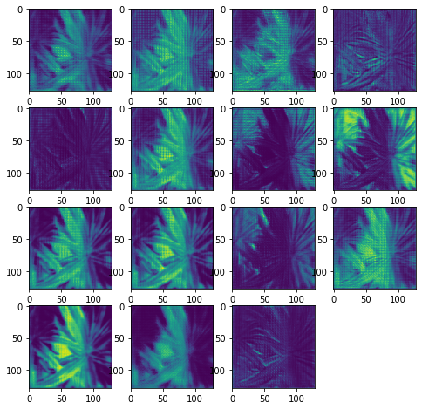
Few Filters of Unet Model

Slide 19
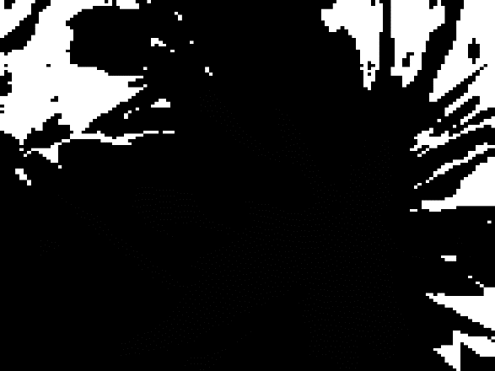



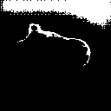
Sample results
Flash Ambient Detected Image

Slide 20
Post-Processing

Slide 21
Post-Processing
Mask Inversion
Regin of Interest (ROI) Identification
Gamma (γ) Extraction
Region of Interest (ROI) Merging
Image Dilation

Slide 22
Post-Processing
The outputs from the shadow detection model are stored.
The non-flash image output is subtracted from the flash image output to determine the shadows that are produced due to the flash and not by natural sources of light.
The mask is resized back to the dimensions of the original image.
The mask is further dilated to improve the results.

Slide 23
Mask Inversion
The mask obtained from the previous stage is stored and is inverted.
The inversion is done by changing on high intensity pixels to low intensity pixels and vice versa.
Both the mask and the inverted mask are used for generation of the shadow free image.

Slide 24
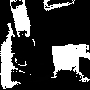
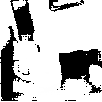
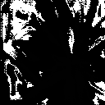
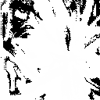
Mask Inversion
Input |  | Output
Flash (BGR) | Ambient (BGR) | Mask | Mask Inversion

Slide 25
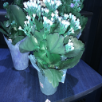

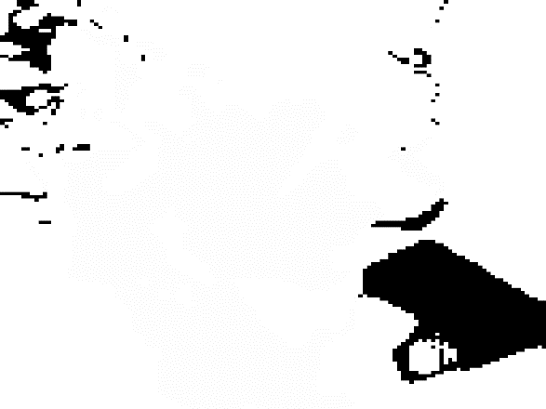
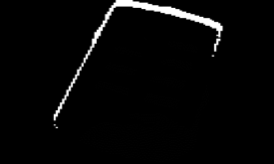
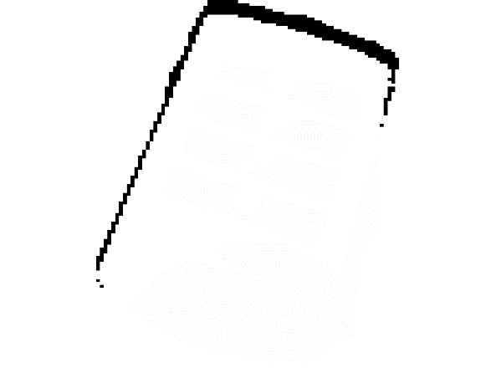
Sample Results
Input (Unaltered) |  | Output(Inversion)
Ambient | Flash | Mask | Mask Inversion

Slide 26

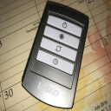

Slide 27
ROI Identification
Mask generated from the U-net model and its inverse(INV) will be used to generate a shadow-free image.
The ambient image is imposed on the mask and the flash image is imposed on the INV which results in 2 images, both of them being shadow-free.
Bitwise AND operation is used to perform the above mentioned process.

Slide 28
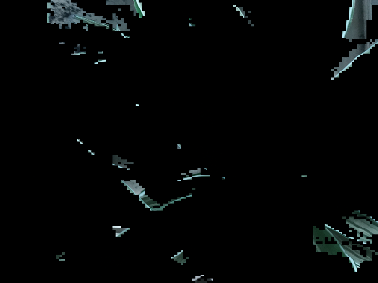
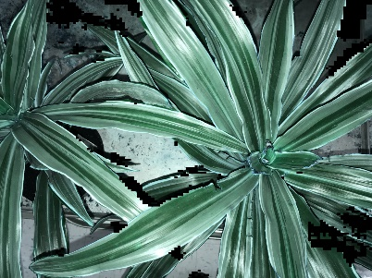
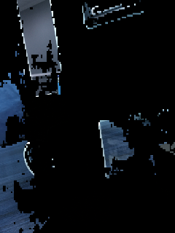
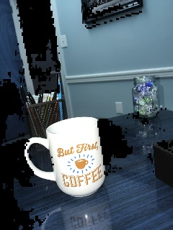
ROI Identification
Shadow Mask | Mask Superimposed (Ms₁) | Shadow Mask Inverted(inv) | Mask Superimposed (Ms₂)

Slide 29
Gamma (γ) Extraction
Method is used to extract the value of the ambient image.
To match the intensity of the ambient image and the flash image power law is used.
The calculation of gamma value is done by comparing the flash and ambient image pixels where there is no shadow.
The mean gamma is then applied to all the pixels of the image which were taken from the ambient image(MS₁)

Slide 30
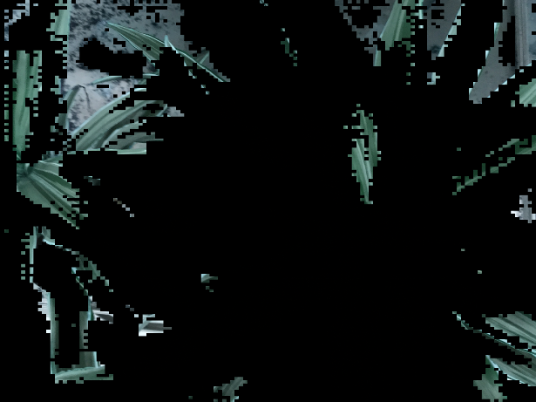

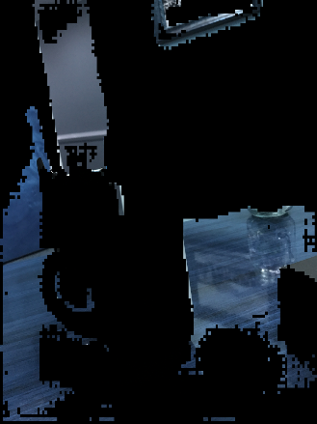

Gamma (γ) Extraction
INPUT: MS1 | OUTPUT: MS3

Slide 31

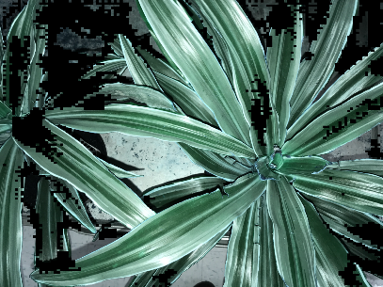
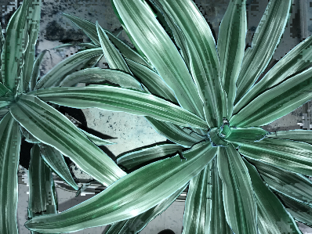

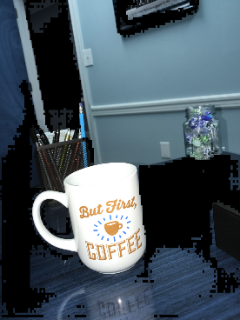
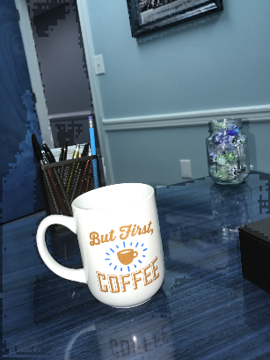
ROI Merging
The images MS3 and MS2 are merged to get shadow free image.
MS3 | MS2 | OUTPUT

Slide 32
ROI Merging
MS3 | MS2 | OUTPUT

Slide 33
Image Dilation
The Merged image that is obtained as shadow free is observed with the rough edges.
To smooth the rough edges dilation operation is performed on the image.

Slide 34


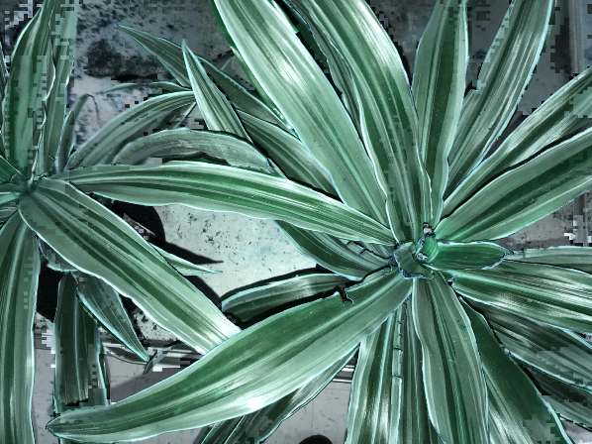
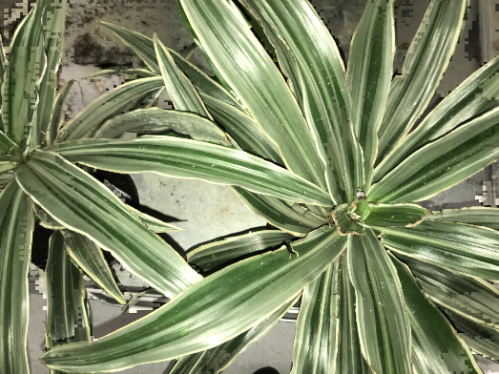
Image Dilation
Input | Output

Slide 35
Performance Analysis
To evaluate the developed methodology two of the performance metrics have been considered such as
Mean Square Error (MSE)
Structural Similarity Index (SSIM)
To study the performance, ground truth images are created and comparison is drawn between the input flash image and output shadow removed and reconstructed image.
The MSE and SSIM values are computed are 11.20% and 0.91 respectively on an image.
The lesser the MSE value the better the image and more closer the SSIM value is to 1 the better the structural similarity of the images are.

Slide 36
Conclusion
A robust reliable shadow detection model is designed and developed.
A data set for training and testing is generated.
The U-Net based fully connected CNN is constructed to perform Image segmentation process. The Process aimed at classifying pixels of shadowed and non-shadowed region
A set of post processing tasks are demonstrated to generate a shadow free image.
The performance analysis to prove the credibility of the developed model is carried out using the measures MSE and SSIM
By analyzing the MSE and SSIM values of 11.20% and 0.91 respectively, the model gives desired results

Slide 37
References
Dataset-
ISTD Dataset: https://drive.google.com/file/d/1I0qw-65KBA6np8vIZzO6oeiOvcDBttAY/view
Results:
https://drive.google.com/open?id=19yDLUssWwouDLhe7cjzdXN8B6emqJ_r

Slide 38
References
Wang, J., Li, X., & Yang, J. (2018). Stacked conditional generative adversarial networks for jointly learning shadow detection and shadow removal. In Proceedings of the IEEE Conference on Computer Vision and Pattern Recognition (pp. 1788-1797).
Xiaodong, C., Chi-Man, P., & Cheng, S. (2019). Towards Ghost-free Shadow Removal via Dual Hierarchical Aggregation Network and Shadow Matting GAN. arXiv preprint arXiv:1911.08718.
Zhu, L., Deng, Z., Hu, X., Fu, C. W., Xu, X., Qin, J., & Heng, P. A. (2018). Bidirectional feature pyramid network with recurrent attention residual modules for shadow detection. In Proceedings of the European Conference on Computer Vision (ECCV) (pp. 121-136).

